Slide 1
Ch.3 Planning and managing the Project

Slide 2
Schedule and cost
Before committing funds for a software development or maintenance project, a customer usually wants an estimate of how much the project will cost and how long the project will take.
Customer’s questions
  Do you understand my problem and my needs?
  Can you design a system that will solve my problem or satisfy my needs?
  How long will it take you to develop such a system?
  How much will it cost to have you develop such a system?

Slide 3
3.1 Tracking progress
A project schedule
  Describes the software development cycle for a particular project by enumerating the phases or stages of a project and breaking each into discrete tasks or activities to be done.
  The schedule also portrays the interactions among these activities and estimates the time that each task or activities will take.

Slide 4
Deliverables and activities to produce these Deliverables
Deliverables(交付的产品)
  The items that the customer expects to see during project development
  Possible Deliverables
    Documents
    Demonstrations of function
    Demonstrations of subsystems
    Demonstrations of accuracy
    Demonstrations of reliability, security, or performance

Slide 5
Activity and milestone
Activity
  An activity is a part of the project that takes place over a period of time. It has a beginning and an end.
milestone
  A milestone is the completion of an activity – a particular point in time. It is the end of a specially designated activity,
Milestones in building a house: Table 3.2, P86

Slide 6
Work breakdown and activity graphs
work breakdown structure
  Describes the project as a set of discrete pieces of work.
  The activities and milestones are items that both customer and developer can use to track development or maintenance.
  The work breakdown structure can be used to track development or maintenance.

Slide 7
Activity graph
Four Parameters to describe activity
  Precursor (前件): is an event or set of events that must occur before the activity can begin; it describes the set of conditions that allows the activity to begin.在活动能开始前必须发生的事件或者事件集合，它描述了允许活动开始的条件集合
  Duration(持续时间): is the length of time needed to complete the activity.
  due date（到期日期）: the date by which the activity must be completed, frequently determined by contractual deadlines.
  endpoint（结束点）: is usually a milestone or deliverable to signify that the activity has ended.
We can illustrate the relationships (interdependence or parts of the project that can be developed concurrently ) among activities by using these parameters.

Slide 8
Activity graph
Activity graph
  Depicts the dependencies among activities;
  The nodes of the graph are the project milestones;
  The lines linking the nodes represent the activities involved. P86, Figure 3.2.
  The figure (Figure 3.2) shows us that several things can be done simultaneously;
  It is important to realize that activity graphs depend on an understanding of the parallel nature of tasks. If work cannot be done in parallel, then the (mostly straight) graph id not useful in depicting how task will be coordinated.(如果任务不是并行的，那么活动图就是一条直线，没啥用了)

Slide 9
Estimating completion
By adding to activity graph information about the estimated time to complete each activity, we can estimate the project completion time.P88,Table 3.3, P89, Figure3.3.
Critical Path Method (detail in P87 to P90)
  The paths can show us the minimum amount of time it will take to complete the project, given our estimates of each activity’s duration(在我们给定每个活动持续时间的估计情况下，关键路径方法可以求出完成项目的最短时间).
  reveals those activities that are most critical to completing the project on time.
Notes:
这里可以用以前软件工程书上的工程网络举例再讲述一下，

Slide 10
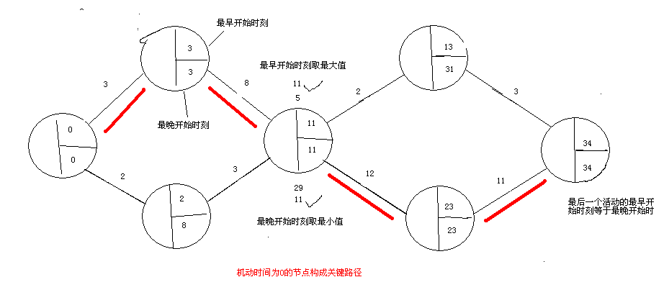
An simple example of Critical Path Method

Slide 11
Tools to track progress
Gantt chart
  A depiction of the project where the activities are shown in parallel, with the degree of completion indicated by a color or icon.
  Figure 3.6, P93
Personnel Resource histogram
  Figure 3.7, P94
Planned VS. actual expenditure line graph
  Figure 3.8, P94

Slide 12
3.2 project personnel
Staff roles and characteristics
  There are many roles for personnel on the development or maintenance team, Key project activities are likely to include:
    Requirements analysis
    System design
    Program design
    program implementation
    testing
    training
    Maintenance
    Quality assurance
  There is great advantage in assigning different responsibilities to different sets of people, offering ”checks and balances”（相互制衡）that can identify faults early in the development process.

Slide 13
3.2 project personnel
Project personnel may differ in many ways, two people with the same job title may differ in at least one of the following ways:
  Ability to perform the work
  Interest in the work
  Experience with similar applications
  Experience with similar tools or languages
  Experience with similar techniques
  Experience with similar development environment
  Training
  Ability to communicate with others
  Ability to share responsibility with others
  Management skills

Slide 14
Differ in project personnel
Some are good at viewing ”the big picture ”, but may not enjoy focusing on detail if asked to work on a small part of large project. Such people may be better suited to system design or testing than to program design or coding.
The feeling of comfort is important; people are usually more productive when they have confidence in their ability to perform.
Interest in the work can also determine someone’s success on a project. The novelty of the work is sometimes a factor in generating interest in it. On the other hand, they are always people who prefer doing what they know and do best, rather than venturing into new territory.

Slide 15
Work styles
Work style determined by two factor
  The way in which your thoughts are communicated and ideas gathered
  The degree to which your emotions affect decision making
Extroverts(外向者) vs. Introverts（内向者）
  Extroverts tell others their thoughts
  Introverts ask for suggestions from others before forming an opinion.

Slide 16
Work styles
Intuitive（感性者） vs. Rational（理性者）
  Intuitive people base their decisions on feelings about and emotional reactions to a problem.
  rational people decide primarily by examining the facts and carefully considering all options.
Figure 3.10, variety work styles, P99

Slide 17
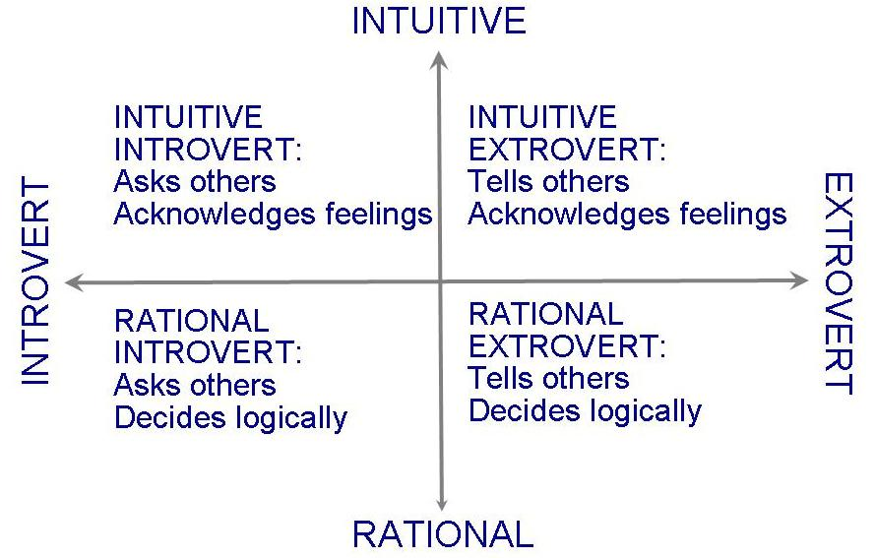
Figure 3.10 work styles

Slide 18
Project organization
Chief programmer team（主程序员组）
  Figure 3.11,P102
  One person (chief programmer) is totally responsible for a system’s design and development. All other team members report to the chief programmer, who has the final say on every decision.
  Minimizes the amount of communications
Egoless (无私的，平等的) approach（民主制程序员组）
  Egoless approach holds everyone equally responsible.(共担责任)
  The process is separated from the individuals;
  Criticism is made of the product or the result, not the people involved;
  All team members vote on a decision.

Slide 19
Project organization
The project suited for chief programmer team
  The project with a high degree of certainty（确定性）, stability（稳定性）, uniformity（一致性）, and repetition（重复性） can be accomplished more effectively by a hierarchical organizational structure such as the chief programmer team.
The project suited for Egoless approach
  When there is much uncertainty involved in a project, a more democratic approach may be better. For example, if the requirements may change as development proceeds, the project has a degree of uncertainty.
  When the level of uncertainty is high, participation in decision making, a loosely defined hierarchy, and the encouragement of open communication can be effective.
Comparison of organizational structure
  Table 3.5，P103
The two types of organizational structure can be combined.

Slide 20
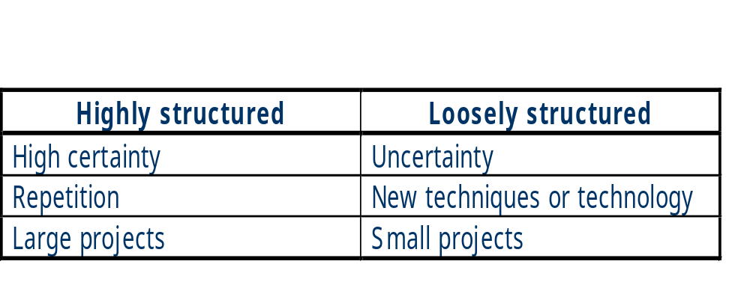
Table 3.5 Comparison of organizational structure

Slide 21
3.3 effort estimation
Estimating project costs
  is one of the crucial(关键，重要) aspects of project planning and management
For project’s planning and management, it is important to know how much the project is likely to cost.
Reasons for inaccurate estimates: Sidebar 3.3,P105
The costs of the project include:
  Facilities
    hardware, space, furniture, and all other items that provide the physical environment in which the developers will work.
    Hidden costs, such as the minimum amount of space needed by programmer.
  Tools
    Software and tools to support development efforts, sometimes called by Computer-Aided Software Engineering (CASE) tools
  Effort(工作量)
    the biggest component of cost
    How many staff-days of effort will be required to complete the project.
Cost, schedule, and effort estimation must be done as early as possible. But estimation should be done repeatedly throughout the lifecycle; as aspects of the project change, the estimate can be refined. P106, Figure 3.12.

Slide 22
Expert judgment
Many effort-estimation rely on expert judgment, based on the competence（能力）, experience（经验）, objectivity（客观性）, and perception（洞察力） of the estimator.
The similarity as the basis for estimates. For example, if system A is similar to system B, then the cost to produce System A should be very much like the cost to produce B.
Analogy process
  The analogy process can be formalized by asking several experts to make three predictions: a pessimistic (x), a optimistic one (z), and a most likely guess (y), then the estimate is the mean of the beta probability distribution determined by these numbers: (x+4y+z)/6;
Delphi technique
  Experts are asked to make individual predictions secretly, based on their expertise and using whatever process they choose. Then , the average estimate is calculated and presented to the group. Each expert has opportunity to revise( 修订，修正) his or her estimate, if desired. The process is repeated until no expert wants to revise.

Slide 23
Expert judgment
Wolverton(1974) model of software development effort estimation
P107, Table 3.6
  Two factors that affect difficulty
    whether problem is old (O) or new (N)
    whether it is easy (E) or moderate (M)
  Can be transported easily to your own development or maintenance environment.

Slide 24
Expert judgment
The drawbacks of Expert judgment
  In general, experiential models, by relying mostly on expert judgment, are subject to all its inaccuracies.
  Projects that appear to be very similar can in fact be quite different. P108, Marathon example .
  Even we know this, the differences how affect the cost we do not always know. The project costs are not always linear(项目成本增加不是线性的).
  Expert judgment suffers not only from variability(差异性) and subjectivity（主观性）, but also from dependence on current data.

Slide 25
Algorithmic methods
To express the relationship between effort and the factors that influence it, researchers creates model that express the relationship between effort and the factors that influence it. The models are usually described using equations, where effort is the dependent variable(应变量), and several factors (such as experience, size, and application type) are the independent variables（自变量）.
Most of these models acknowledge that project size is the most influential factor in the equation.
In most equations, the efforts is determined mostly by the size of the proposed system.
  E = (a + bS^{c}) m(X)
Walston and felix model
  E = 5.25S ^{0.91}
  Supplemented with a productivity index that reflected 29 factors that can affect productivity, P109, Table 3.7.
Bailey and Basili model
  E = 5.5 + 0.73S^{1.16} Other factors that affect effort, P110, Table 3.8

Slide 26
COCOMO Ⅱ model
Boehm COCOMO, COCOMO Ⅱ model, detail in P111 to P115
Almost all the Algorithmic methods are based statistical conclusion, so they subject to the statistic samples. Maybe dot not adapt to today’s software development, but inspire us to create Algorithmic methods ourselves.

Slide 27
COCOMO Ⅱ model
Boehm(1981)develped the original COCOMO model in the 1970s. Considering software development from both an engineering and an economics viewpoint, Boehm used size as the primary determinant of cost and then adjusted the initial estimate using over a dozen cost driver(成本驱动因素) including attributes of the staff, the project, the product, and the development environment. In the 1990s, Boehm updated the original COCOMO model, creating COCOMO Ⅱ to reflect the ways in which software development had matured.(反映了软件开发变得成熟以后的各方面)

Slide 28
COCOMO Ⅱ estimation process
COCOMO Ⅱ estimation process reflects three major stages of any development project.
At stage1, projects usually build prototypes to resolve high-risk issues involving user interfaces, software and system interaction, performance, or technological maturity.
Here little is known about the likely size of the final product under consideration, so COCOMO Ⅱestimates size in what its creators (Boehm命名的) call application points. This technique captures size in terms of high level effort generators, such as the number of screens and reports, and the number of third-generation language components.

Slide 29
COCOMO Ⅱ estimation process
At stage 2 , the early design stage, COCOMO Ⅱ employs function points as a size measure, estimate the functionality captured in the requirements, so they offer a richer system description than application points.
By stage 3, the postarchitecture stage, sizing can be done in term of function points or lines of code.

Slide 30
COCOMO Ⅱ model
The basic model is of the form:
  E = bS^{c}m(X)
  where
    bS^{c} is the initial size-based estimate
    m(X) is the vector of cost driver information
P112, Table 3.9 describes the cost drivers at each stage.

Slide 31
At stage 1, to computer application points
We first count the number of screens, reports, and third-generation language components that will be involved in the application.
Next, we classify each application element (screens, reports, components) as simple, medium, or difficult. P113, Table 3.10 contains guidelines for this classification.
The number to be used for simple, medium, or difficult application points is a complexity weight found in P113, Table 3.11.
we sum the weighted reports and screens to obtain a single application point number. If r percent of the objects will be reused from previous projects, the number of new application points is calculated to be:
New application points= application points×(100-r)/100
We use an adjustment factor, called a productivity rate, P114, Table 3.12, based on developer experience and capability with CASE maturity and capability, to adjust new application points. The new application points is divided by productivity rate.
At stage 1, the cost drivers are not applied to this effort estimate.

Slide 32
The cost drivers in stage2 and stage 3
At stage 2,the effort estimate, based on a function-point calculation, is adjusted for degree of reuse, requirements change, and maintenance.
The scale (the value for c in the equation, 即等式里的参数c,也是表格3.9中的Scale (c) ) ranges from 0.91 to 1.23, depending on the degree of novelty（创新性） of the system, conformity(一致性), early architecture and risk resolution, team cohesion, and process maturity.

Slide 33
The cost drivers in stage2 and stage 3
The cost driver in stage2 and stage3 are adjustment factors expressed as effort multipliers (工作量系数，即m(x)的乘数) based on rating your project from “extra low” to “extra high”, depending on its characteristics.
A development team’s experience with an application type is considered to be:
  Extra low if it has fewer than 3 months of experience
  ……
  Extra high if it has at least 4 years of experience

Slide 34
The cost drivers in stage2 and stage 3
Analyst capability is measured on an ordinal(有顺序的) scale based on percentile ranges. for instance , the rating is “very high” if the analyst is in the ninetieth percentile and “nominal” for the fifty-fifth percentile. Correspondingly, COCOMO Ⅱ assigns an effort multiplier ranging from 1.42 for very low to 0.71 for very high. These multipliers reflect the notion that an analyst with very low capability expends 1.42 times as much effort as a nominal or average analyst.
P114, Table 3.13 lists the cost driver categories for tool use, and the multipliers range from 1.17 for very low to 0.78 for very high.
Tool are available that implement COCOMO Ⅱand compute the estimates from the project characteristics that you supply.

Slide 35
3.4 risk management
Risk
  an unwanted event that has negative consequences
Risk management
  to understand (identification, analysis) and control the risks on the projects
Boehm’s top ten risk items
  Sidebar 3.4,P119

Slide 36
What is a risk?
Distinguish risks from other project events
  A loss associated with the event
    A loss of time, money, quality, control, understanding, and so on.
    The loss associated with a risk is called the Risk Impact.
  The likelihood that the event will occur
    the likelihood of the risk, measured from 0(impossible) to 1(certainly) is called the risk probability
  The degree to which we can change the outcome
    Risk control involves a set of actions taken to reduce or eliminate a risk.

Slide 37
Risk exposure, Generic risks and Project-specific risks
Risk exposure
  We can quantify the effects of the risks we identify by multiplying the risk impact by the risk probability, to yield the risk exposure.
Two major sources of risk
  Generic risks
    Common to all software projects
  Project-specific risks
    Threats that result from the particular vulnerabilities(弱点，缺点) of the given project.

Slide 38
Risk management activities
Figure 3.15,P121
First, assess the risks on the project, so that we understand what may occur during the course of development or maintenance.
  identifying the risks
    By decomposing the process into small pieces, we may be able to anticipate problems that may arise.
  Analyzing the risks
    We can understand as much as possible about when , why, and where they might occur.
  Assigning priorities to each of risks
    Enable us to devote our limited resources only to the most threatening risks.
Computing the risk exposure, figure3.16,P122

Slide 39
Risk management activities
Second, control the risks
  Risk reduction
    Strategies: Avoiding the risk, Transferring the risk, Assuming the risk
    Risk leverage
      (risk exposure before reduction – risk exposure after reduction)/(cost of risk reduction)
    Choose prototyping model to help reduce the risk
  Risk planning
    Risk management plan
    Monitor the project’s progresses, periodically reevaluating the risks, their probability, and their likely impact
  Risk resolution(消除,化解)

Slide 40
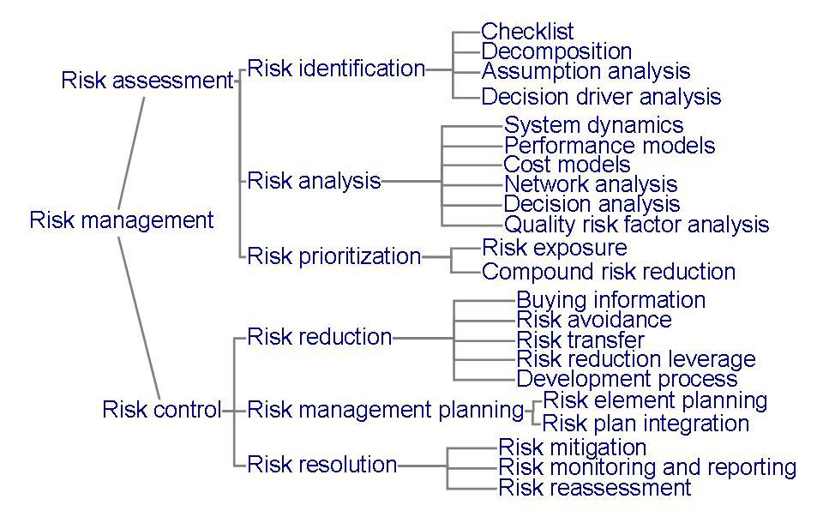
Figure 3.15 steps in risk management

Slide 41
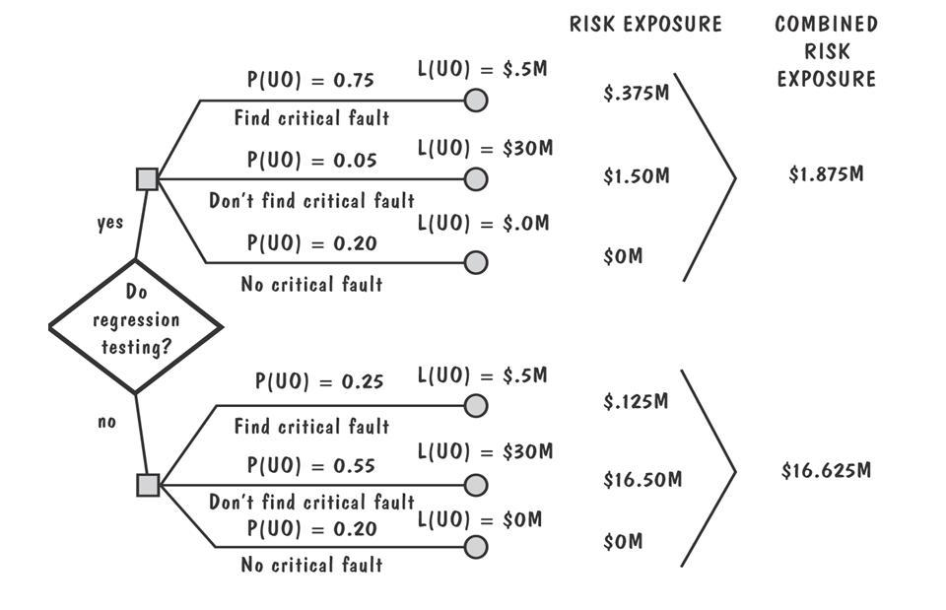
figure3.16 example of risk exposure calculation

Slide 42
3.5 The project plan
Project plan
  A document used to communicate risk analysis and management, project cost estimates, schedule, and organization to our customers.
  The items included in a good project plan
    Project scope
    Project schedule
    Project team organization
    Technical description of the proposed system
    Project standard, procedures, and proposed techniques and tools
    Quality assurance plan
    Configuration management plan
    Documentation plan
    Data management plan
    Resource management plan
    Test plan
    Training plan
    Security plan
    Risk management plan
    Maintenance plan

